Slide 1
Process Mining Project
Process Mining about customer journey analysis in an
cosmetic E-commerce with AI support.
Presented by Gadaleta Tiziano

Slide 2

Process Mining
It's a data-driven approach that enhances Business Process Management (BPM) by using event logs from IT systems to reveal how processes actually run, uncovering bottlenecks and deviations, whereas traditional BPM often relies on subjective, manual inputs (interviews, workshops) for idealized model.

Slide 3

01
Dataset

Slide 4
E-commerce of cosmetic products
The dataset used in the project was released on the Kaggle platform by
Michael Kechinov in 2020 and contains behavioral data from a medium-sized
cosmetics online store for the month of February.
Each row in the file represents an event.
All events are related to products and users. Each event is like a many-to-many relationship between products and users.

Slide 5
4 event types
1.723.228
931.669
View, cart, remove from cart, purchase
Events
Unique user sessions

Slide 6
Original file structure
Property | Description
event_time | Time when event happened at (in UTC).
event_type | Type of the event.
product_id | ID of a product.
category_id | Product's category ID.
category_code | Product's category taxonomy (code name) if it was possible to make it.
brand | Downcased string of brand name. Can be missed.
price | Float price of a product. Present.
user_id | Permanent user ID.
user_session | Temporary user's session ID. Same for each user's session.

Slide 7
Dataset pre-processing
Dimensionality reduction
Incomplete observation
to maintain computational efficiency of discovery algorithms by selecting 10,000 unique cases that have a minimum of
2 activities per session.
have been removed by deleting rows without session identifiers and removing events with invalid or uninterpretable timestamps.
Renaming CSV columns
Generate new dataset
according to the XES standard, an
XML-based standard for representing event logs.
normalized into a new CSV file with
118,237 rows. Without directly modifying the original file, in the future it will be possible to modify and carry out new tests on a greater number of unique cases.

Slide 8

02
Process Discovery

Slide 9
Process Discovery Introduction
Process discovery is one of the central techniques of Process Mining and consists of automatically reconstructing a process model using only data recorded in information systems. The model, rather than starting from a theoretical or documented description of the operational flow, is created by observing the behavior traced in event logs. This approach allows for an objective representation of the processes actually executed, often revealing deviations, unexpected loops, or alternative paths that would otherwise be unknown in the formal specifications.

Slide 10
Discovery Algorithms
Alpha Miner
Heuristic Miner
Inductive Miner
A deterministic process discovery algorithm that constructs a Petri net from directly-follows relations in the event log.
It produces the same model for the same input, assumes noise-free logs, and can highlight deviations from the ideal process.
A frequency-based mining algorithm that extends deterministic approaches by considering the occurrence of events and traces.
It filters infrequent behavior to manage complexity and noise, emphasizing the main process paths while providing an interpretable model.
A recursive process discovery algorithm that identifies structural cuts (sequential, parallel, concurrent, and loops) in the log and builds submodels for each segment.
The resulting model is sound, structured, robust to noise, and uses unique labels for visible transitions, while allowing some unobserved or skipped behavior.

Slide 11
Quality Metrics for Model Evaluation
Fitness
Precision
Measures how much of the observed behavior in the event log can be replayed by the model. High fitness means the model can reproduce most traces, while perfect fitness reproduces all traces from start to end.
Indicates how much of the behavior allowed by the model actually occurs in the log. High precision means the model avoids allowing unnecessary behavior, while low precision reflects underfitting, permitting behavior not seen in the log.
Generalization
Simplicity
Assesses the model’s ability to handle future or unseen behavior. Good generalization prevents overfitting, ensuring the model captures the underlying process structure without being too specific to the log.
Refers to how easy the model is to understand and interpret. A simple model avoids unnecessary complexity, often measured by factors like the number of nodes or the shortest path length between start and end.

Slide 12
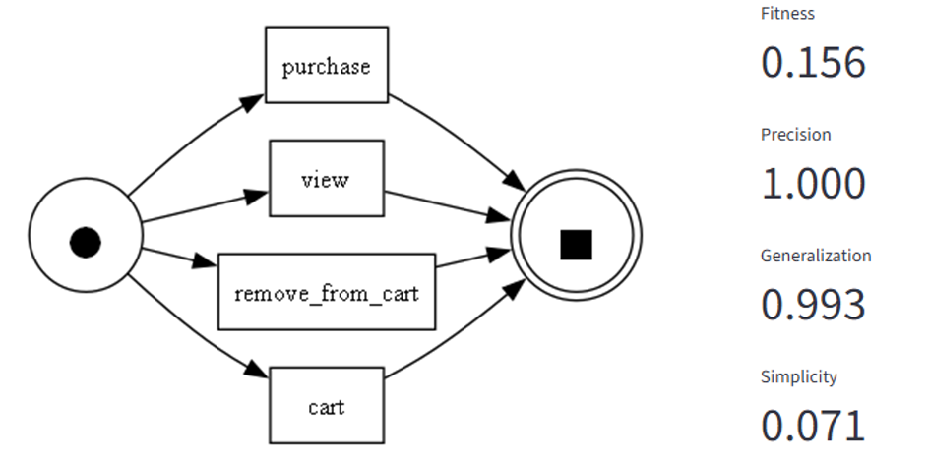
Alpha Miner result

Slide 13
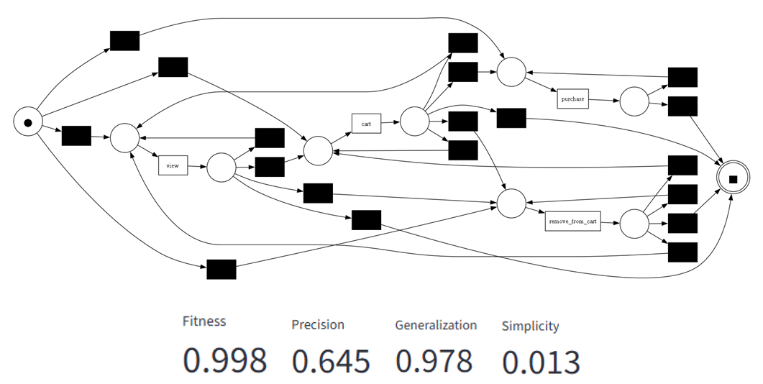
Heuristic Miner result

Slide 14
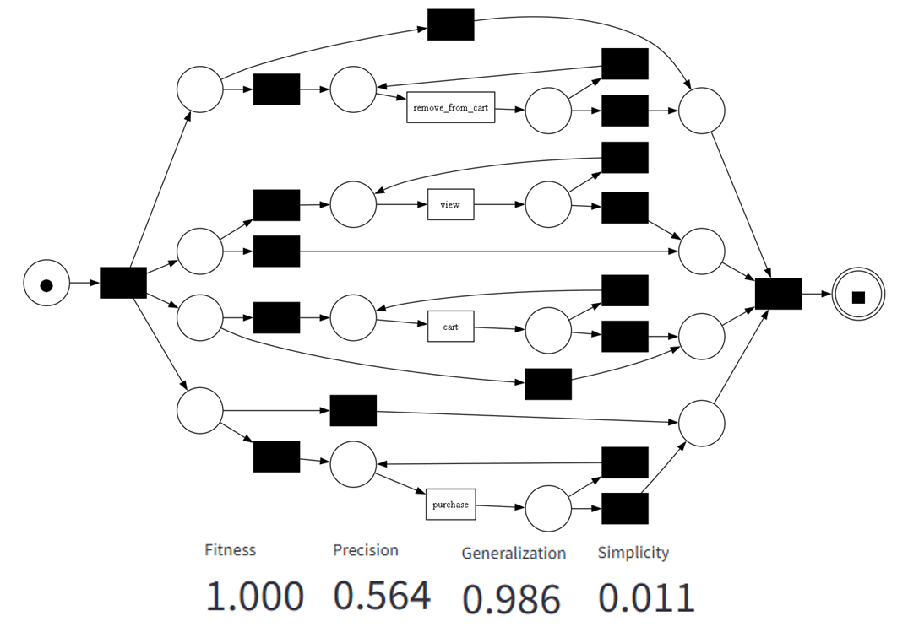
Inductive Miner result

Slide 15
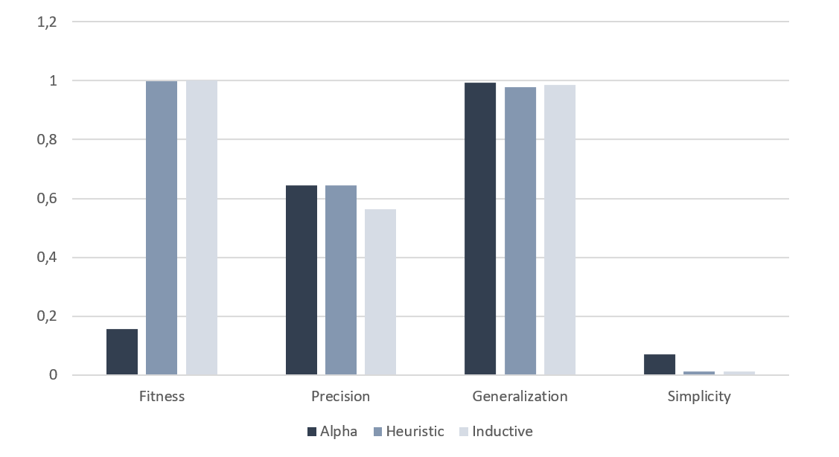
Model comparison

Slide 16
Model comparison
Alpha Miner | The model is extremely simple and rigid. Precision is perfect (1.000), meaning it allows only the behaviors seen in the log, but fitness is very low (0.156), reproducing only a small portion of real cases. This reflects Alpha Miner’s limitations with loops, alternative paths, and noise typical of real e-commerce logs, making it oversimplified and less representative of actual user behavior.
Heuristic Miner | The model balances data adherence and descriptive power. Fitness is very high (0.998), while precision (0.645) allows some unobserved behavior, filtering noise to increase flexibility. Generalization (0.978) is strong, supporting future variations in user behavior, but simplicity (0.013) is low, reflecting structural complexity and a rich variety of user paths. This makes it effective for analyzing real-world, noisy processes, at the cost of interpretability.
Inductive Miner | The model achieves perfect fitness (1.000), reproducing all cases in the log. Precision (0.564) is lower, allowing additional paths not seen in the log, which can be useful for predictive analysis. Generalization is very high (0.986), indicating robustness and adaptability to future variations in user behavior, making it well-suited for dynamic e-commerce environments.

Slide 17

03
Next Event Prediction

Slide 18
How does Prediction works?
A specific part of the project is dedicated to the probabilistic prediction function of the next event, considering a sequence of transitions as input. The prediction of the next event is based on the analysis of historical user behavior patterns. The system does not use machine learning or deep learning models, but simply a frequency-sequential logic, observing what happened most frequently in the past when a specific sequence of actions occurred.

Slide 19
How does Prediction works?
Starting from a normalized event log, events are grouped by session and ordered chronologically to generate traces representing complete user paths. Given an input sequence of events, the system scans all stored traces to count how often the sequence occurs and records which event follows each occurrence. This builds a statistical distribution of transitions, where the most frequent next event is predicted as the most likely continuation. If the sequence has never appeared before, the system cannot make a reliable prediction and returns a “None” state, typically occurring when sequences are very specific or the dataset is small.

Slide 20
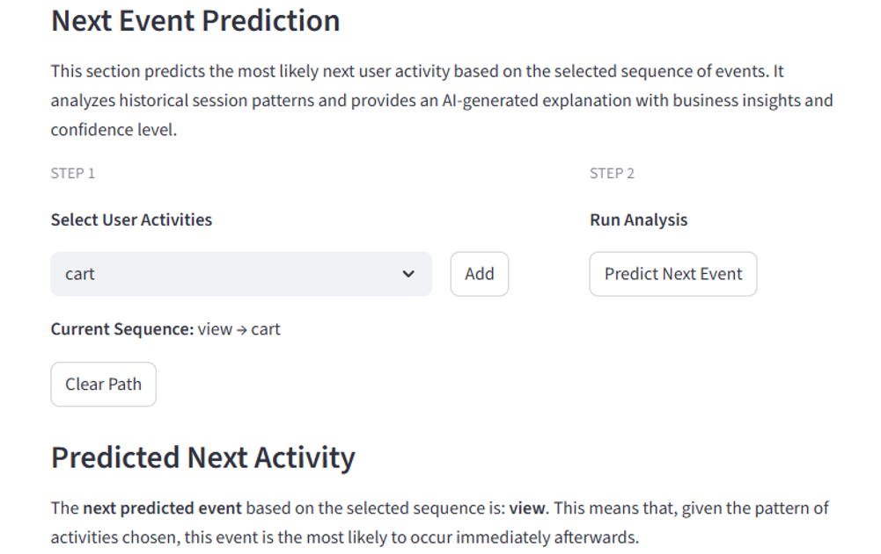
Prediction

Slide 21

04
Artificial Intelligence

Slide 22

Its Role in the Project
AI supports key project functions using Large Language Models (LLMs) for semantic analysis, report generation, decision support and analysis of algorithm results.. Integration is via OpenAI Python and OpenRouter, allowing access to multiple models through a single interface.
The NVIDIA Nemotron-3 Nano 30B was chosen for its reliability, stability, and performance, which met the project's objectives.

Slide 23
Prediction Support
01
The system predicts the next user action based on historical frequencies and uses an LLM to generate an explanatory report on that prediction.
The AI provides: - Business-oriented reasoning for the prediction, - Offers 3–5 operational recommendations to improve
process efficiency and user experience, - Concludes with a confidence score for the forecast.

Slide 24
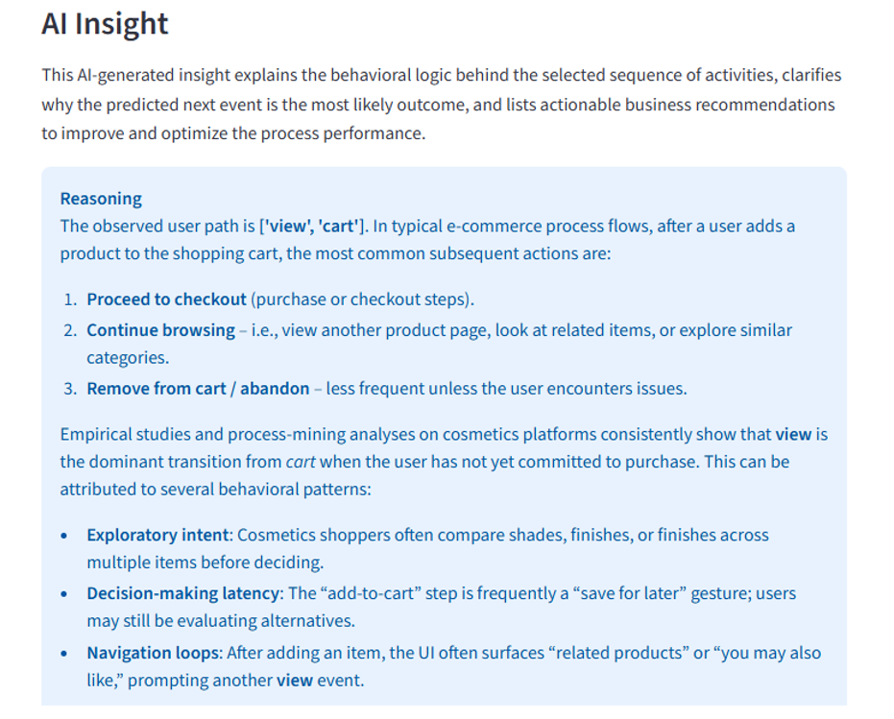
Prediction Support

Slide 25
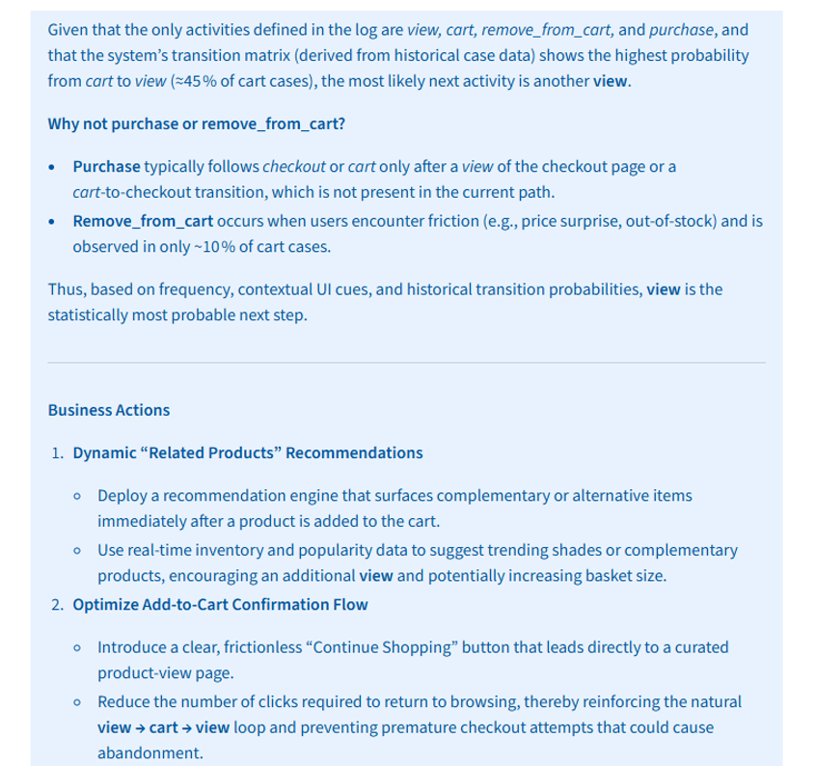

Slide 26
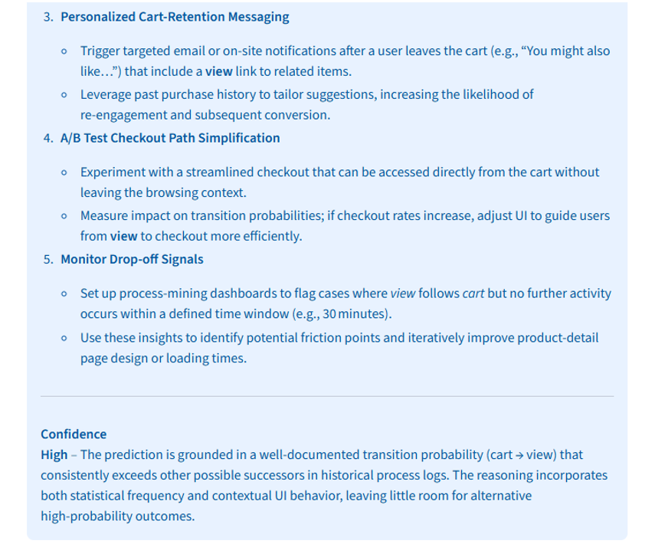

Slide 27
AI Strategic Process Report
02
After loading and formatting the event log for PM4Py, the system calculates key metrics such as:
total sessions,
event counts per session,
most frequent activities,
exit activities,
unique process variants.
The LLM then interprets these metrics to generate a structured report, highlighting patterns, potential bottlenecks, user experience issues, and providing strategic recommendations. The final output is organized into three sections: Reasoning, Observations, and Recommendations.​

Slide 28
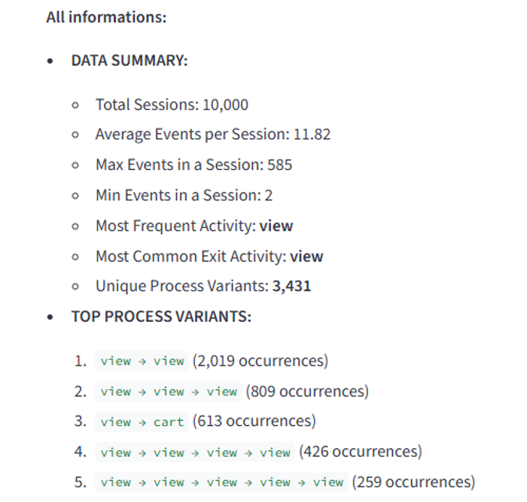
Report Genereted

Slide 29
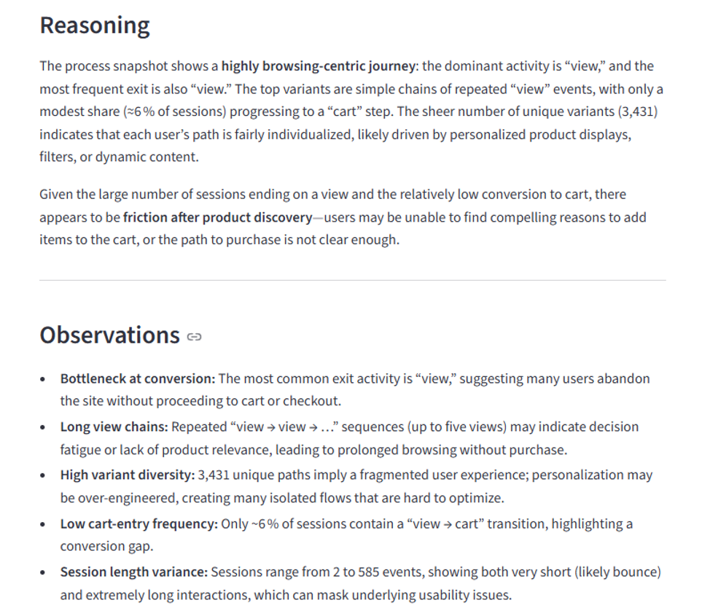

Slide 30
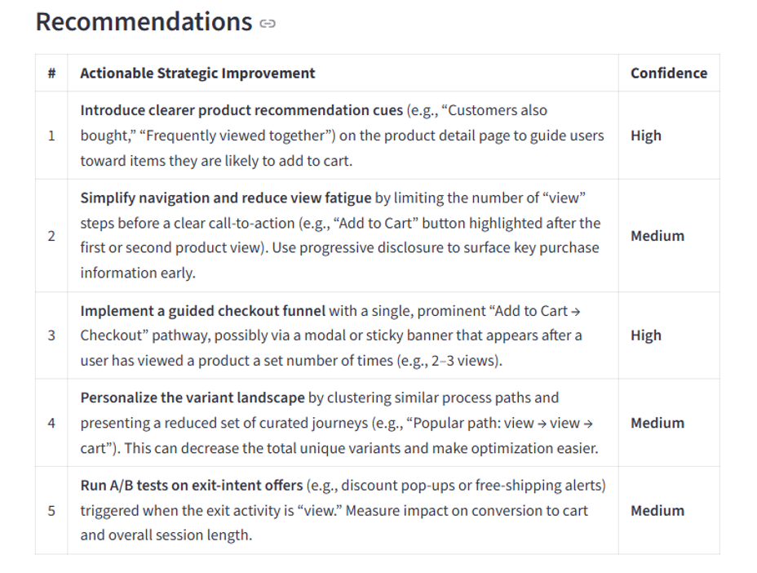

Slide 31
AI Chatbot
03
The AI chatbot provides real-time answers about process discovery results. It has knowledge of models generated by Alpha, Heuristic, and Inductive Miners, including their quality metrics, and allows users to ask about process flows, differences between algorithms, anomalies or explanations of performance metrics.

Slide 32
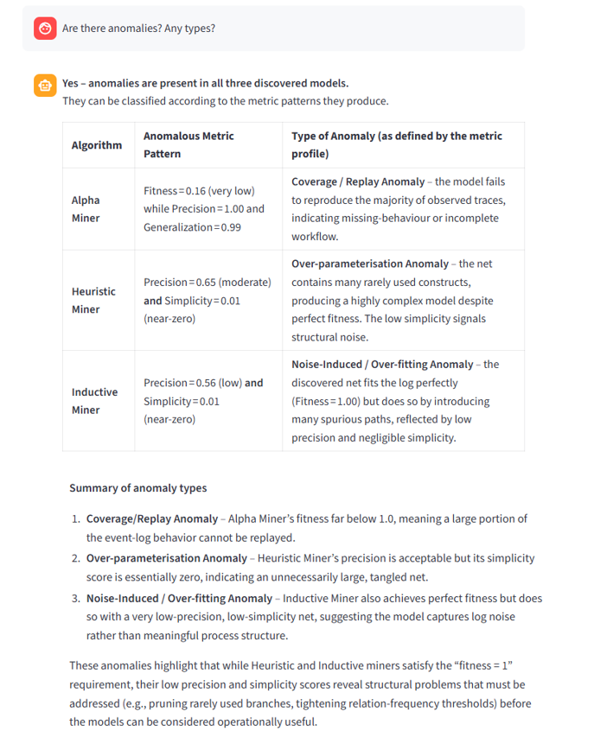
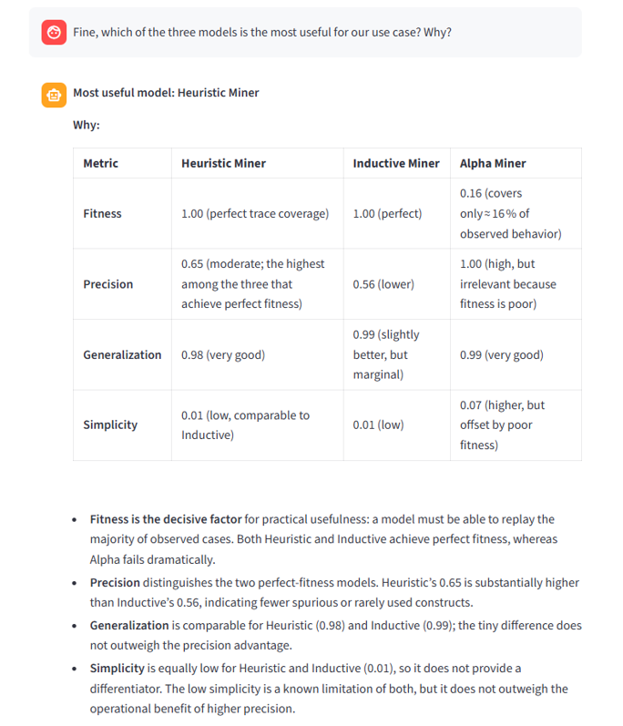

Slide 33

05
Interactive Dashboard

Slide 34
Interact with the Informations
All the information presented so far is made available through an interactive dashboard developed with Streamlit. The dashboard acts as a centralized access point where users can explore event log statistics, process discovery models, quality metrics, prediction results, and AI-generated reports in a clear and structured way. This design supports iterative exploration and comparison of different mining algorithms, while also facilitating interaction with AI components such as reports and the chatbot. Overall, the dashboard enhances usability and makes complex process mining results accessible for both technical and business-oriented users.

Slide 35
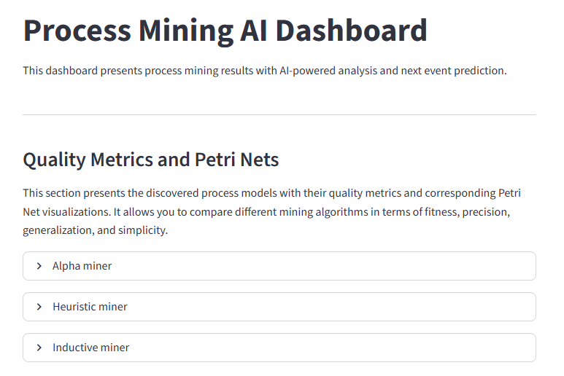

Slide 36
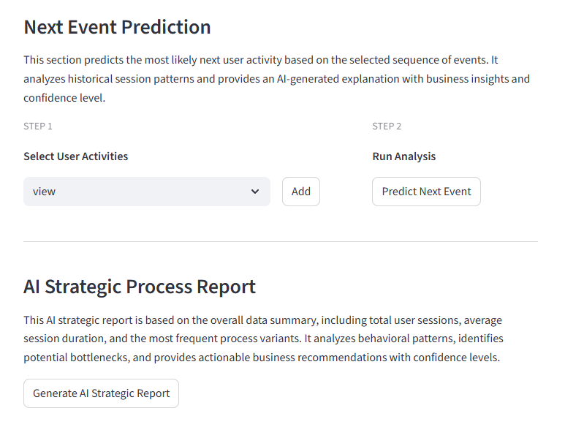

Slide 37
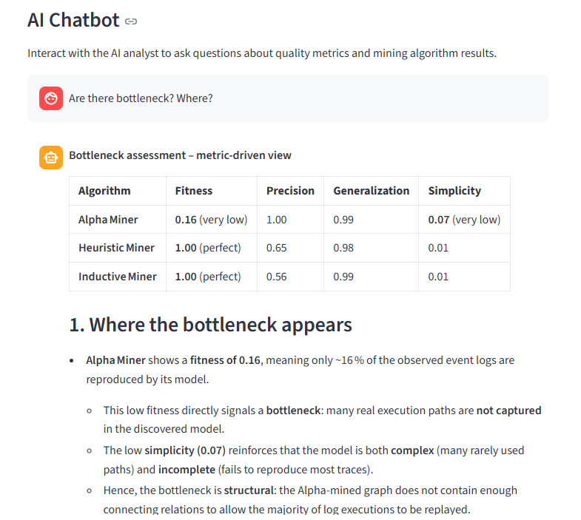

Slide 38
Thank you for your attention!
Process Mining Project Gadaleta Tiziano

